Slide 1

ITSM Now Assist POC Project
PM Introduction
October 28, 2025

Slide 2
Agenda
  Introductions
  Overview of Statement of Work (SOW)
  Stakeholders & Project Team
  Key Roles & Responsibilities
  Delivery Excellence/Project Methodology
  Project Tools
  Communication & Meetings Planning
  Next Steps
  Q/A

Slide 3
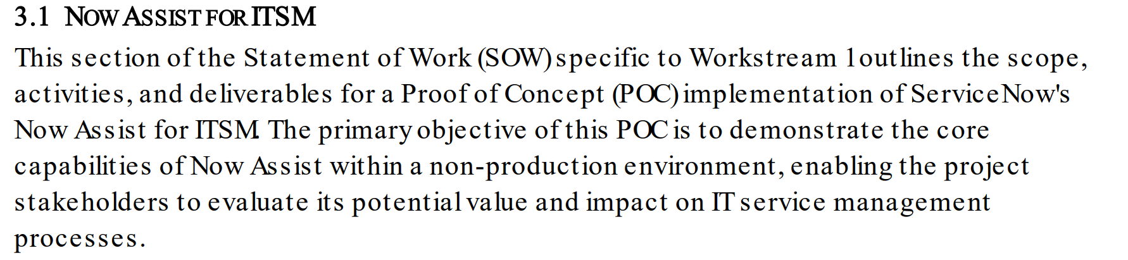
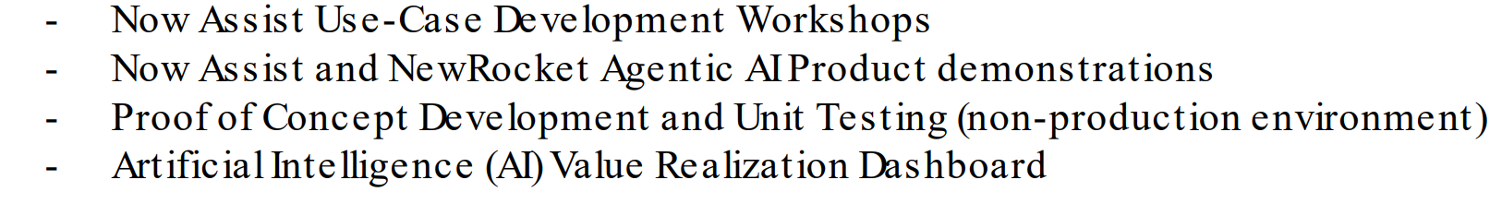
Statement of Work (SOW) Overview – In Scope

Slide 4
Stakeholders & Project Team
    NewRocket
    Lisa Brown – Area Delivery Director
    Yitbarek Redda – Project Manager
    Anusha
    Pankaj Yadav – Solution Architect
    Mylene Nadeau - Business Process Architect
    Ashish Kaushik – Engineer/Technical Consultant
    Boeing
    Project Sponsor (?)
    Project Manager
    SME's
    SN Platform Owner
    SN Architect
    Name - [Position], Project Role

Slide 5
Key Roles and Responsibilities
    NewRocket
    Develop project schedule
    Lead Status calls
    Lead Steering Calls
    Manage budget
    Maintain RIDAC
    Manage and monitor project budget
    Lead workshops
    Create stories backlog
    Manage sprints
    Manage sprint ceremonies
    Resolve UAT issues
    Co-manage Release to (Pre) Production
    Resolve post Go-live issues
    Boeing
    Identify stakeholders
    Complete Readiness Homework
    Prepare for Kick-off
    Prepare for Workshops
    Participate in Workshops
    Participate in Follow-up Sessions
    Review and Approve Stories
    Participate in weekly status
    Validate developed stories
    Validate design
    Plan, lead UAT
    Manage defect log
    Manage Release to (Pre) Production

Slide 6
Delivery Excellence Methodology
Initiate
Kickoff
Team Alignment
Plan
Demonstration & Elicitation Workshops
Document requirements/stories
Execute
Deliver Development Sprints (SNOW, Integrations, Data, etc.)
Demos
Deliver
Close
Strategies
Project Planning, discipline
Execute Planning (Sprints, tests, )
Reviews
Delivery Planning
Testing (Functional, SIT, UAT, data, etc.)
Training
Operational Readiness
Go-No Go
Transition to operations
Hypercare
Safe Landing
Great Launch
Project Close
Production Release
ServiceNow NowCreate Methodology
NewRocket best practices added where appropriate

Slide 7
Project Tools
Project Plan: To assist with timeline visualization and order of operations, your NewRocket Project Manager will be managing and maintaining a Gantt-style project plan to be reviewed weekly during the status call.
RIDAC Log: Tracking Risks, Actions, Decisions, Actions, and Changes (RIDAC).
Status Report: Used to run our weekly status calls and summarize the project to key stakeholders. This report will contain information such as; Overall Status, Risks and Issues, Development Overview, Timeline and Budget.
Meeting Notes/Minutes: All meetings will be accompanied by meeting notes/minutes capturing action items and summary of discussion.
Story & Blocker Review Calls: Weekly working sessions will be scheduled to provide the Boeing team and NewRocket team to review story progress and work through questions.
SCRUM Calls: If needed to aid in both team’s management of open action items, a series of SCRUM calls can be set up for 15 min each to review open action items.

Slide 8
Communication & Meetings Planning
    Time zone(s) and working hours: Eastern Time (ET) - UTC-4, 9:00 AM-2:00 PM
    File sharing tools: Microsoft Teams / SharePoint
    Communication channels: Microsoft Teams / SharePoint
    Establish weekly Status Meeting cadence: Weekly basis. PMs, Functional Leads (optional)
    Schedule weekly PM to PM meetings : Weekly basis.
    Establish Steering Committee cadence (if necessary) : Monthly basis. Boeing Leadership, NR Leadership
    Identify Governance chain of command : same as 6
    Managing change: Robust internal process via formal change control process and will initiate if any additional scope is identified during executing the project

Slide 9
Timeline Considerations
    SOW Timeline [8 weeks] Start Date: Monday October 27, 2025
    End Date: Friday, December 19, 2025
    Client or Regulatory requirements:
    Business drivers affecting timeline:
    Onboarding process (steps and duration):
    NewRocket access to SN instance/portal:
    Kick-off meeting planning: Tuesday November 4, 2025 1:30 PM – 2:30 PM [ET]
    Clone down schedule, upgrade considerations, etc.
    Company holidays
    Team PTO
    Blackout Dates

Slide 10
Next Steps
    Complete Pre-flight checklist
    Prepare for workshops
    Touchbase –Friday October 31, 2025
    Kickoff
    WS1 Friday October 7
    Ws2,

Slide 11

Questions?

Slide 12
Success Criteria
Outcomes & Success Criteria
Raving Fans
Solution Quality
NewRocket looks at success along four dimensions.
Building trust through transparency and open communication
Exceed expectations via good strategic partnering
CSAT Score of “Excellent”
Meeting the expected business outcomes
Based on guiding principles
On-time and On-budget
Partnership
Proactive use of Project Change Orders (PCOs)
Proactive use of Risks, Issues, Actions, Decisions, and Change Orders (RIDAC)
Zipper relationship

Slide 13
Delivering an Extraordinary Experience
At NewRocket, we believe every client deserves an extraordinary delivery experience. Every project and client is unique. Our Project Managers and Crew Members are some of the best in the industry and ready to make sure you receive an extraordinary experience!
To ensure you are a raving fan, we will:
Build a trusted relationship with you acting as a strategic partner
Follow a consistent delivery methodology
Promote open and honest two-way communication
Check in regularly and ask, “How are we doing?”
Act on feedback
Measure project success using our Project Pulse Check Process and ServiceNow’s CSAT Survey process
Hold lessons learned and continuously improve based on feedback

Slide 14

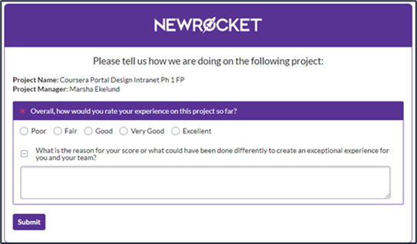
Client Satisfaction
Outcomes & Success Criteria
At NewRocket we measure Client Satisfaction using the following two methods:
Pulse Check Survey Process
  At specific checkpoints in the project the NewRocket Project Manager will initiate a Pulse Check Survey to measure client satisfaction. An email is sent with one question and a comments section. Your participation is critical to our success and let’s our crew know what is going well and areas we may need to work on. Proactively addressing issues and open communication will ensure a successful project!
ServiceNow CSAT Survey
  During the delivery phase the Project Manager will review if the project meets the ServiceNow Deployment Registration Requirements. If the project is determined a good fit, a deployment will be created and completed during the delivery phase. A part of the deployment ServiceNow sends out a Client satisfaction (CSAT) survey on behalf of the partner to measure success and gather feedback.
The ratings and feedback received is very important to NewRocket for continuous improvement and being able to pro actively address issues while a project is in flight. Our Project Crew are dedicated to earning a rating of “Excellent” and Client Participation is important.
If there are ever ANY issues during the project that would keep you from rating NewRocket as “Excellent”, please reach out to your project manager or account executive to discuss the issue and we will make it right!

Slide 15
Expectations – Solution Architect
Owns technical solution for customer
Technical escalation
Ensure stories are technically sound, estimated, and can be worked on by developer(s)
Leads sprint demo and planning meetings with assistance from development team and project manager as necessary
Coach developers
Peer review stories prior to sprint demoes

Slide 16
Expectations – Business Process Analyst
Leads Workshops
Story Writing
Tracks action items from Workshops

